Slide 1
Extraction of largest complete subgraph for a given graph
Presented By:-
Maharshi Roy (ISM2014006)
Rajat Kumar Sahu (IHM2014501)
Amrit Daimary (IRM2014001)

Slide 2
Methodology and Approach
We present two methods for finding maximal cliques for a given graph.
First one goes by the name of Bron-Kerbosh.
And the second one goes by the name of Branch and Bound.

Slide 3
Bron Kerbosch Algorithm
It is a recursive backtracking algorithm that searches for all maximal cliques in a given graph G.
More generally, given three sets R, P, and X, it finds the maximal cliques that include all of the vertices in R, some of the vertices in P, and none of the vertices in X.
In each call to the algorithm, P and X are disjoint sets whose union consists of those vertices that form cliques when added to R. In other words, P ∪ X is the set of vertices which are joined to every element of R.
When P and X are both empty there are no further elements that can be added to R, so R is a maximal clique and the algorithm outputs R.

Slide 4
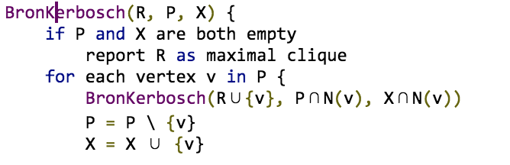
Bron Kerbosch Algorithm

Slide 5
Branch and Bound Method
A branch & bound recursive algorithm for finding maximal cliques works as follows.
For each recursive, we have an initial vertex to start from.
For each call, we keep a separate set of remaining vertices, and in each call stack, we attempt to add a vertex to the set of included vertices if it satisfies the full connectivity condition, thus maintaining the complete connectivity property.
If we are unable to find any such vertex, we compare the size of the clique found to the best solution and update it if the current size exceeds it.
The time complexity of the algorithm has been found out to be O((2^n)* n).

Slide 6
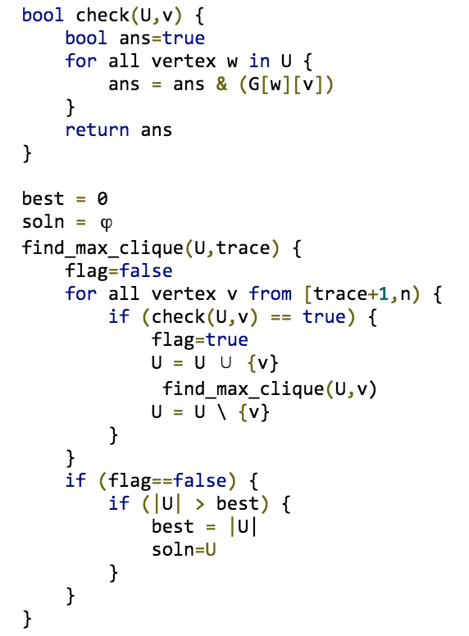
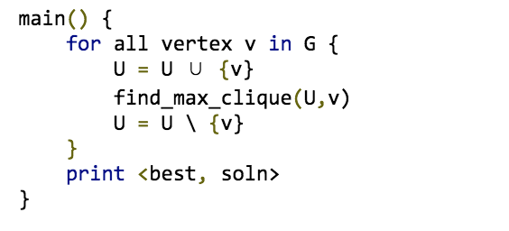
Branch and Bound Method

Slide 7
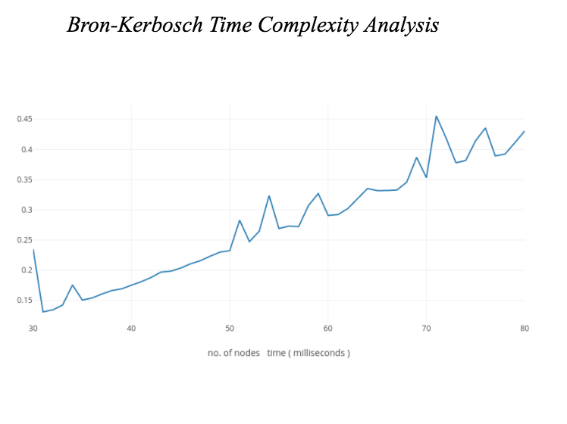
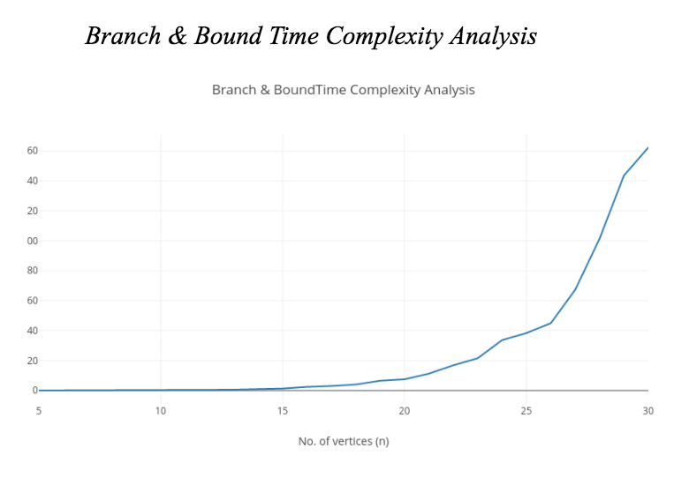
COMPLEXITY ANALYSIS

Slide 8
THANK YOU

